Slide 1




Youth in the Great Outdoors
Engaging, Educating, and Employing Young People in the U.S. Fish & Wildlife Service (FWS)
Drew Burnett
U.S. Fish and Wildlife Service
National Conservation Training Center
Division of Education Outreach
Arlington, VA
Notes:
I’m relatively new at FWS, so if anyone has additional suggestions, please chime in!
Show of hands: how many FWS employees in the room? How many participants have worked with FWS staff or resources in the past?
We’ll begin today’s session with a brief overview of the Initiative at the Departmental level, then move on to provide an overview of how we are implementing it here in the service with a focus on a key efforts underway at NCTC. We should have about 10 – 15 minutes at the end for questions group discussion.
Youth was a priority for the Secretary from the very beginning and it was a specific focus of the Administration’s America’s Great Outdoors Initiative.

Slide 2
Session Objectives
Explain the goals & objectives, and key programs & activities of the Youth in the Great Outdoors Initiative at the Fish and Wildlife Service.
Provide an overview of the agency’s organization and strategies PLT facilitators can use to tap expertise, personnel, and potential funding.
Review key federal student employment authorities and anticipated changes in the coming year.
Discuss additional strategies for integrating career/employment opportunities into PLT programming through partnerships with FWS and/or other Federal agencies.

Slide 3

Why Youth?
13% of the U.S. Fish and Wildlife workforce is currently eligible for retirement, up from 2.2% in 2004.
73% are above the age of 40.
6.3% of our workforce is below the age of 30, The average age of all permanent employees is 46.
Richard Louv’s book Nature Deficit Disorder
Notes:
We need to provide pathways or a pipeline for hiring youth if we are to find the kind of employees we need to manage our resources in the future.
We need to begin engaging youth early on to develop interests in the outdoors and the natural environment through recreational and educational experiences that culminate in part time and for some full time work.
Book demonstrates how disconnected our nation’s youth have become from the natural world, and have become increasingly wired with technology.
We hope you will find this afternoon’s session helpful in understanding what the Department and the Service are doing to improve and enhance our youth programming, and that you will freely offer your ideas for how we can improve our efforts within the Service.

Slide 4
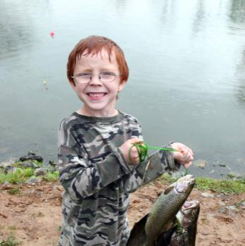
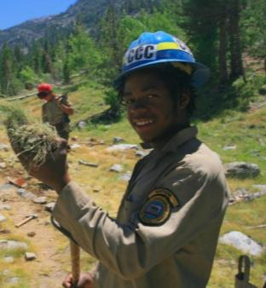
FWS YGO Goals
Goal 1: Employ youth to protect our communities and restore our environment.
Goal 2: Educate youth about our lands, waters, wildlife, culture and heritage.
Goal 3: Engage youth from all backgrounds, all walks of life.
Notes:
Explain that we’ll now focus on the Service and these goals are being implemented agency-wide through out the various organizational units within the agency.

Slide 5
FWS YGO Activities
Engage
Educate
Connecting People with Nature:
  Neighborhood Explorers
  Regional Funding Initiative
Scouting and 4-H
Nature Play Corps
Let’s Go Outside
Get to Know (G2K)
Junior Duck Stamp Program
Shorebird Sister Schools
Schoolyard Habitat
Nature of Learning
Hands on the Land
Scouting and 4-H
Natural Resource Career Symposium
Notes:
Mention that the list of programs is not comprehensive and is a sampling.
FWS is highly decentralized and as such doesn’t have “national” educational programs that are funded or coordinated centrally.
Handout the one page flier with additional information on each of the programs mentioned on the next two slides. The handout will allow participants to find additional information on each of the programs mentioned either through a website link or an email/phone number of a FWS staffer responsible.
Handout Jr. Duck Stamp Fact Sheet.
Mention that both Jr. Duck and Schoolyard both have new curricula that are available on line.

Slide 6
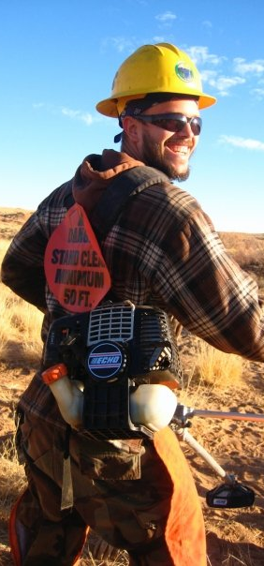
FWS YGO Activities
Employ
Hiring
Youth Conservation Corps
Pathways (STEP, SCEP, & PMF)
Public Land Corps
Partnerships: Americorps, SCA, NEEF, WDNR, TWS
Federal Student Ambassador Program
Professional Development
Career Discovery Internship Program
Mentoring Training
Career Awareness Toolkit
Notes:
Youth Conservation Corps: High School Students (handout)
Pathways: College Students, Recent Graduates, and Presidential Management Fellows
Public Land Corps Hiring Authority: Partnership Hires (high school and college)
Go to Youthgo.gov (handout)

Slide 7

Internet One Stop Shop
Notes:
Work in progress
Right now, best place for one stop for all DOI bureaus.

Slide 8
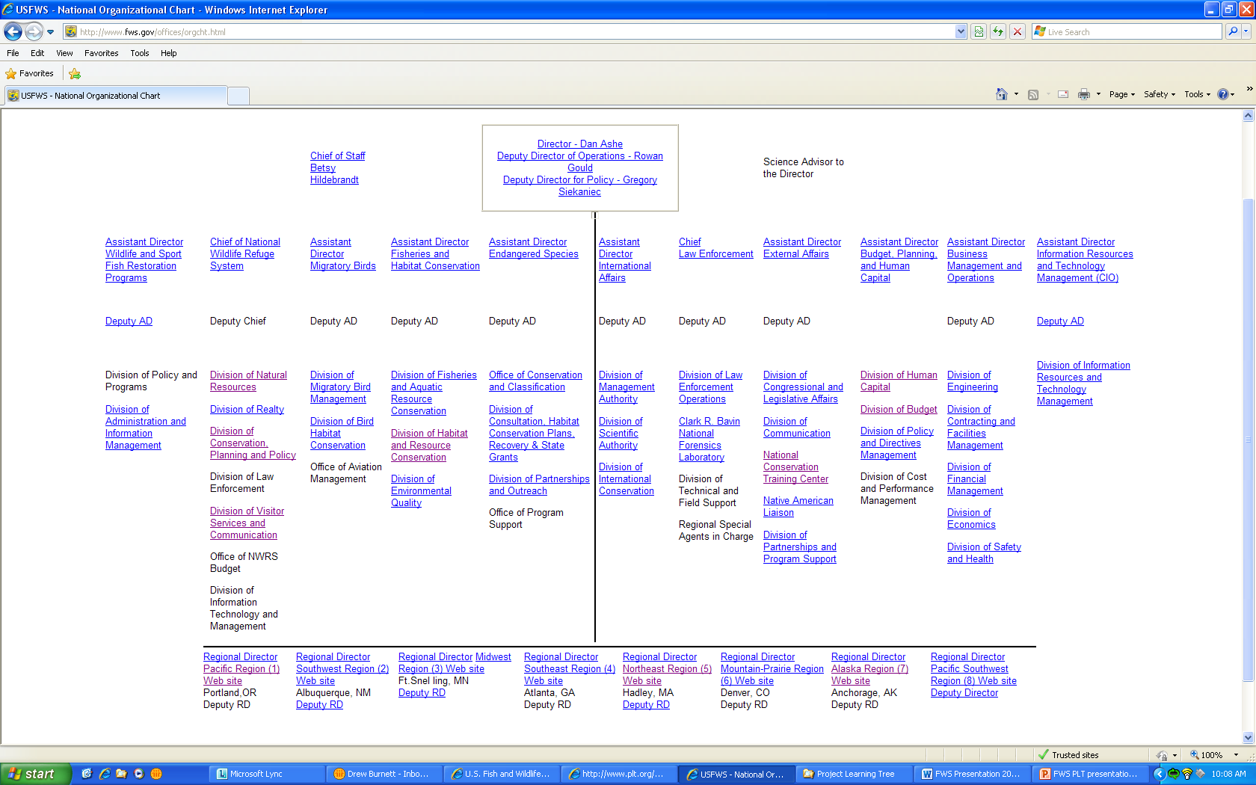
FWS National Organization
Notes:
Key to everything is to as clearly as you can identify what you want from FWS: technical assistance, funding, expertise, site visit, education program support, employment program support?
Point out key levels of organization: Director, Assistant Director, and Regional Director.
Explain that Regional organization infrastructure will not exactly mirror the national organization.
Key is to start with the Regional Office.

Slide 9
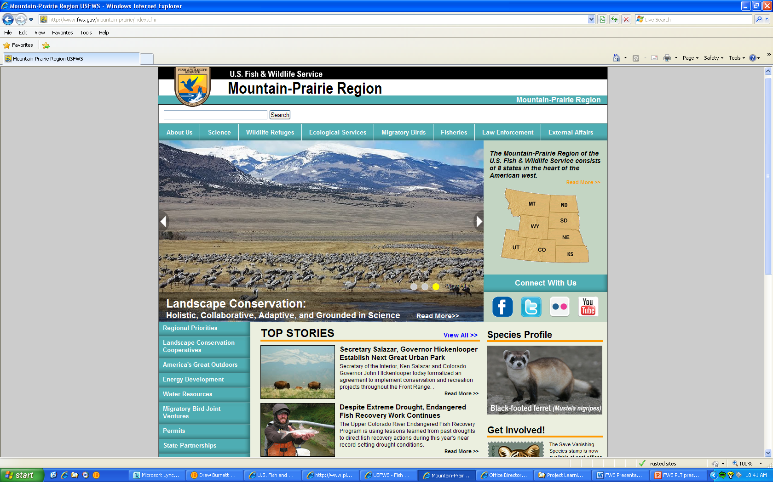
FWS Regional Organization
Notes:
Begin by learning about the key priorities in the Region of interest. Think of ways that your interests can support or address these priorities.
Remember funding is allocated for specific priorities – so if you can link your interests to those priorities, you will be more successful at tapping the agency for support.
Contact the most appropriate regional coordinator to begin inquiring about the best way to partner with the agency.
Try various regional coordinators if you don’t make progress. Call me if you get stuck!

Slide 10
Key Regional Office Contacts
Youth Coordination Team Regional Coordinator
Jr. Duck Stamp Regional Coordinators
External Affairs Office
Connecting People with Nature Regional Coordinator
Fisheries Conservation Education Regional Coordinator
Pollinator Regional Coordinators
Notes:
Use these regional coordinators to identify potential people and or programs that would be of interest.

Slide 11
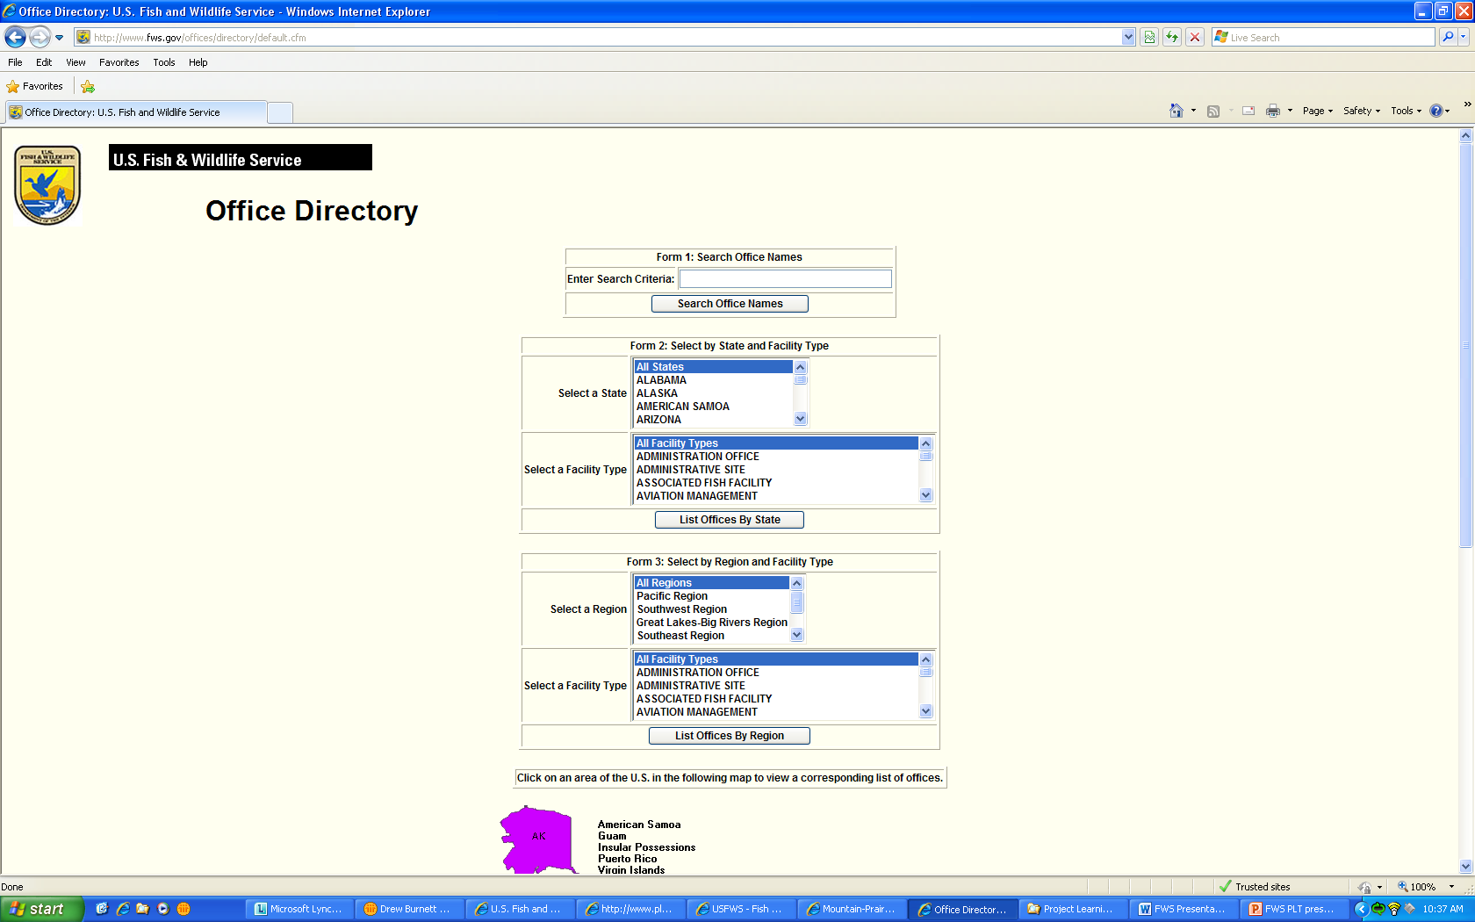
FWS Field Unit Organization

Slide 12
Key Field Facilities
National Wildlife Refuge
National Fish Hatchery
Migratory Bird Coordinator Office
Ecological Service Field Office
Wildlife Inspector Office
Regional Fire Coordinator Office
Notes:
These field facilities will be the most likely to have staff that are working in the arena of communications, education, or are experts in a scientific field of interest.

Slide 13
DOI & CoSTEM
Federal Committee on STEM Education – White House Office of Science and Technology Policy
DOI STEM Education and Employment Pathways Strategic Plan. maria_arnold@ios.doi.gov
Guidance for STEM-related program/activity development and evaluation
Potential funding for STEM-related programs is unknown at this time
Notes:
America Competes Act created Co-STEM to inventory and coordinate Federal STEM programs, and develop a five year federal strategic plan for STEM Education.
Maria Arnold in YPS coordinating representatives from USGS, NPS, FWS, BOEM, BIA/BIE, BLM, BOR to develop DOI plan. Expect publication by fall 2012.
The plan will serve to help guide field units in STEM-related program development and evaluation. Funding resources are unknown at this time.

Slide 14
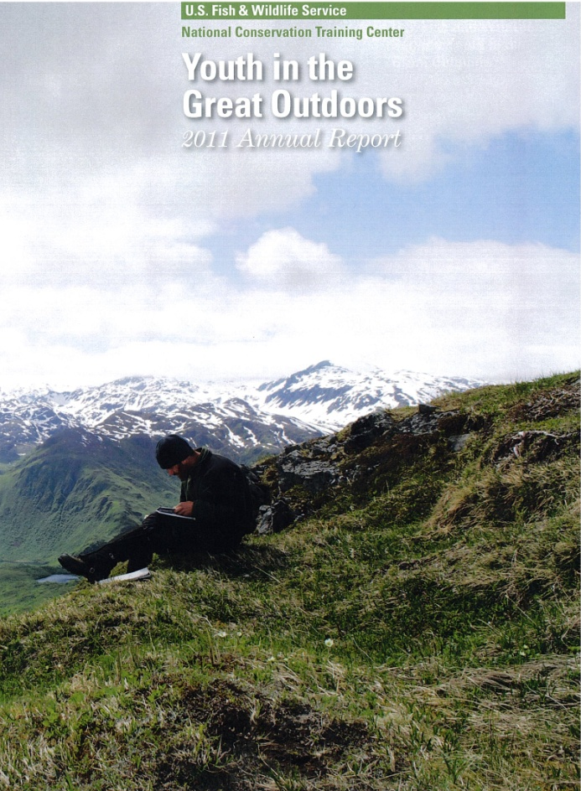
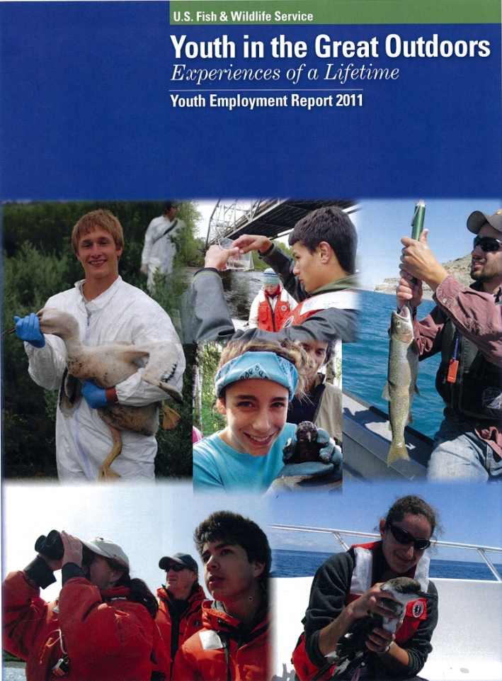
Learn More:
http://nctc.fws.gov/documents/YGOAnnualReport2011.pdf
http://nctc.fws.gov/documents/YGO-2011-Annual-Employment-Report-Final.pdf
Notes:
1. I won’t go into detailed explanation of accomplishments due to time – please see our reports. I’ve got a couple of copies for you here today, or alternatively you can go on line. Simpley google the titles of the reports and you can find the URLs.

Slide 15
Questions & Discussion
Drew Burnett
U.S. Fish and Wildlife Service
National Conservation Training Center
Division of Education Outreach
Arlington, VA
703-358-2606; drew_burnett@fws.gov
Notes:
Discuss additional strategies for integrating career/employment opportunities into PLT programming through partnerships with FWS and/or other Federal agencies.

